Slide 1

SEMINAR
ON
Deepfake Video Detection Using Neural Network
Presented by
Pranay V. Shahare
Tejaswini V. Hirudkar
M.Sc. - Semester IV (Computer Science)
Under the guidance of
Dr. S. R. Gedam
Assistant Professor
DEPARTMENT OF COMPUTER SCIENCE
Shri Shivaji Education Society Amravati’s,
SCIENCE COLLEGE
Congress Nagar, Nagpur-440012.
2021-22

Slide 2
Introduction
Results
01
06
Objectives
Conclusion
07
02
Methodology
Future Scope
03
08
Model Architecture
Tools and Technologies
04
09
Data Exploration
10
References
05

Slide 3
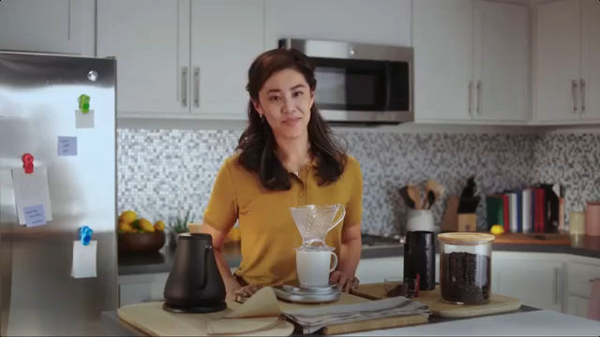
Introduction
Deep fake is a technique for human image synthesis based on artificial intelligence.
Deep fakes are created by combing and superimposing existing images and videos onto source images or videos using a deep learning technique known as generative adversarial network.

Slide 4
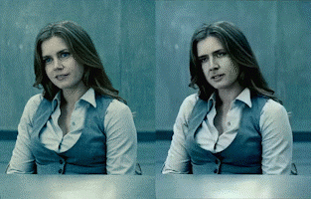

Objective
1. To create deepfake video using available applications (Zao, Deep Art, Wombo).
2. To detect a deepfake video using neural network.

Slide 5
Methodology
As deep fakes are spreading faster than expected and creating very serious issues, it is necessary to have automatic tools and technologies to detect fake content.
Deep Fake Creation
Architecture
Dataset
Pre-Processing
CNN
The flow of methodology applied is :-
LSTM

Slide 6
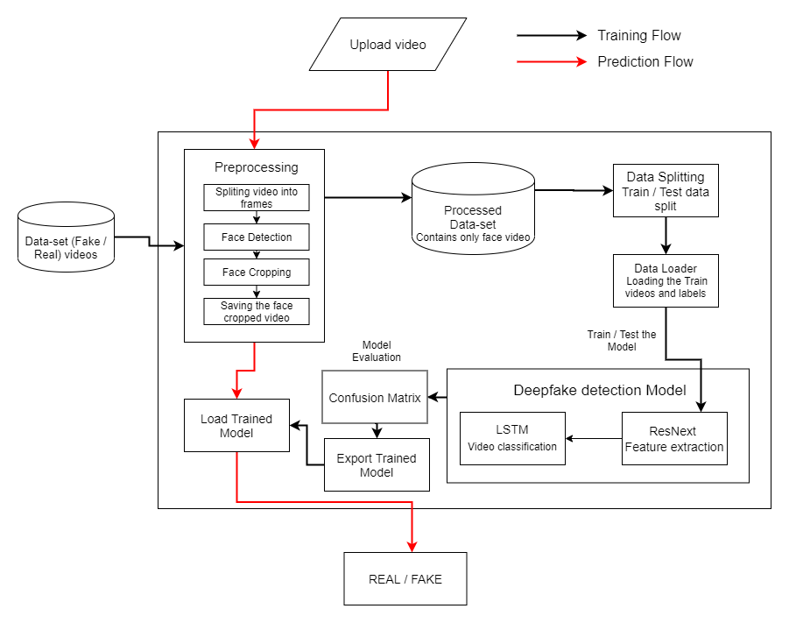

System Architecture

Slide 7
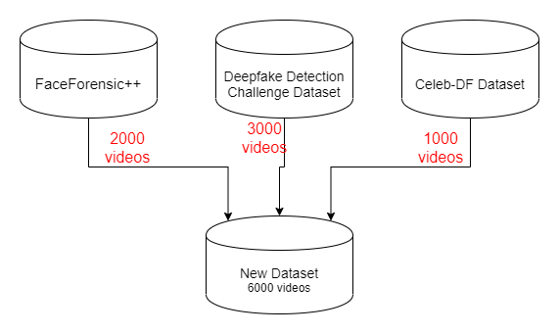
Data-set Exploration

Slide 8
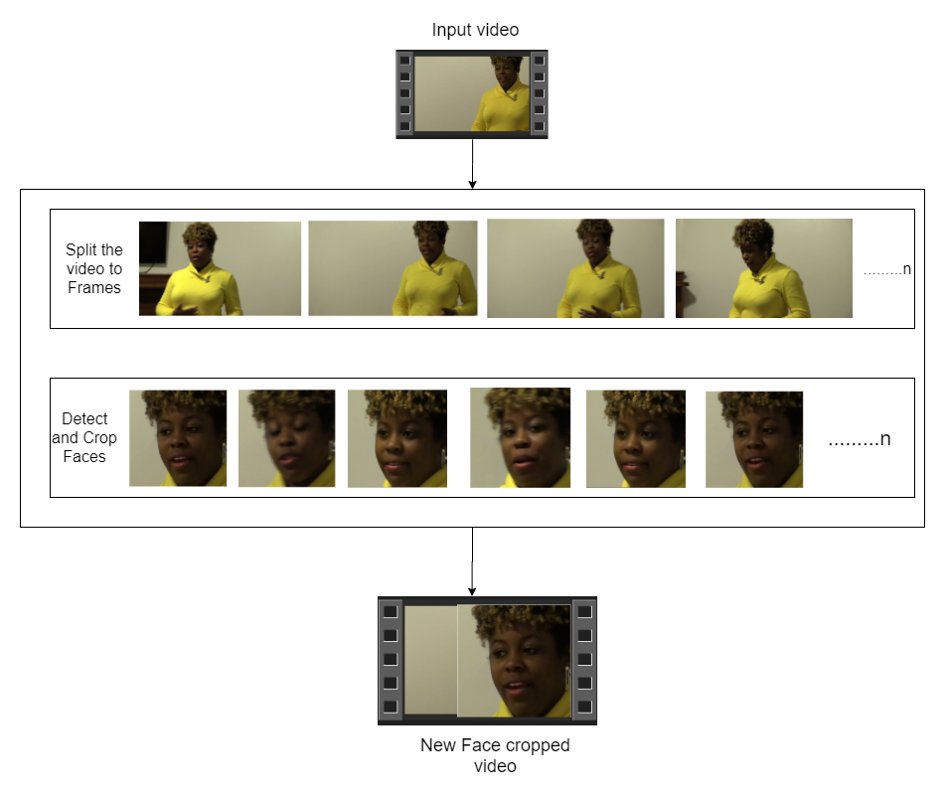

Pre-processing
SPLIT VIDEO INTO FRAMES
FACE DETECTION
5
4
3
2
1
CROPING FACE
CREATING NEW FACE CROPPED VIDEO
SAVING THE FACE CROPPED VIDEO

Slide 9
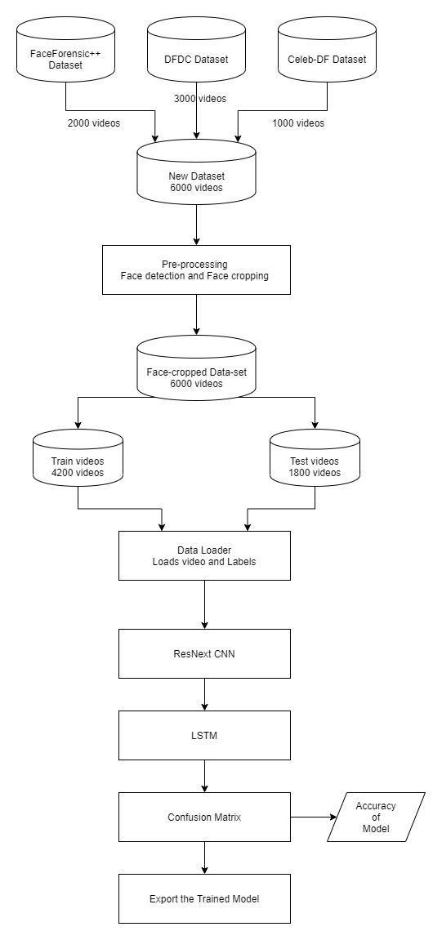
Training
Workflow

Slide 10
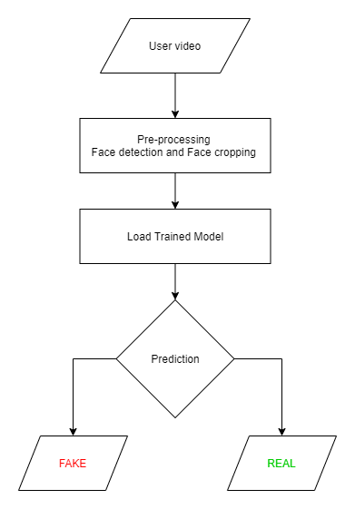
Prediction Workflow

Slide 11
Results
Model Name | Dataset | No. of Videos | Sequence Length | Accuracy
model_90_acc_20_frames_FF_data | FaceForensic++ | 2000 | 20 | 90.95477387
model_95_acc_40_frames_FF_data |  |  | 40 | 95.22613065
model_97_acc_60_frames_FF_data |  |  | 60 | 97.48743719
model_97_acc_80_frames_FF_data |  |  | 80 | 97.73366834
model_97_acc_100_frames_FF_data |  |  | 100 | 97.76180905
model_84_acc_10_frames_final_data | Our Dataset | 6000 | 10 | 84. 662519
model_87_acc_20_frames_final_data |  |  | 20 | 87.79160186
model_89_acc_40_frames_final_data |  |  | 40 | 89.3468118195956
model_91_acc_60_frames_final_data |  |  | 60 | 91.5909797822706
model_92_acc_80_frames_final_data |  |  | 80 | 92.4981855883877
model_93_acc_100_frames_final_data |  |  | 100 | 92.10883877

Slide 12
Conclusion
Thus, Deepfake videos were studied and analyzed using this methodology and it also produces a good level of accuracy. The frames of the video were extracted and preprocessing was done. Subsequently, Image Classification was done and the images were labelled. With the help of Machine Learning algorithms, predictions were made on the dataset. Thus, any video can be analyzed using this methodology. It helps in detecting fake faces in a video which may have been manipulated, hence can prevent individuals from being defamed unknowingly.

Slide 13
Future Scope
Our method has not considered the audio. That is why our method will not be able to detect the audio deep fake. But we can propose to achieve the detection of the audio deep fakes in the future.

Slide 14














Programming Languages
Python3
JavaScript
Programming Frameworks
PyTorch
Django
Tools and Technologies
IDE
Google
Jupyter Notebook
Visual Studio Code
Cloud Services
Google Cloud Platform
Version Control
Git

Slide 15
References
Anuj Badale, Chaitanya Darekar, Lionel Castelino, Joanne Gomes, “Deepfake Video Detection Using Neural Netwok”, International Journal of Engineering Research and Technology, ISSN: 2278-0181, NTASU 2020, (April 2021)
Yuezn Li, Siwei Lyu, “ Exposing Deepfake Videos By Detecting Face Warping Artifacts”, Institute of Electrical and Electronics Engineers, arXiv: 1811.00656v3 [cs.CV] (May 2019)
T.T. Nguyen, Q. V. H. nguyen, C. M. Nguyen, D. T. Nguyen, Saied Nahavandi, “ Deep Learning for Deepfakes creation and Detection”, Institute of Electrical and Electronics Engineers, arXiv: 1909.11573v3 [cs.CV] (April 2021)
Aarti Karandikar, Vedita Deshpande, Sanjana Singh, Sayali Nagbhidkar, Saurabh Agrawal, “ Deepfake Video Detection Using Convolutional Neural Network” , International Journal of Advanced trends in computer Science and Engineering, ISSN 2278-3091, Volume 9 No. 2 (April 2020)
Abdul Jamshhed V. Janet B. , “ Deep Fake Video detection Using Recurrent Neural Network” , International Journal of Scientific Research in Computer Science and Engineering, E-ISSN: 2320-7639, Volume 9, Issue:2 (April 2021)

Slide 16
Pavel Korshunov, Sebastien Marcel, “Deepfakes A New Threat to face recognition? Assessment And Detection” , arXiv:1812.08685v1 [cs.CV] (December 2020)
Akhil Sunil Kumar, Amruta Khavase, Himesh Rajendran, “ Deepfake Video Detection Using Neural Nnetwork”, International Journnal of Innovative research in technology, ISSN; 2349-6002, Volume 7, Issue 12, (May 2021)
Ruben t. Ruben Vera-Rodriguez, Julian Fierrez, Aythami Morales, Javier Ortega-Garcia, “ DeepFake and Beyond: A Survey of Face Manipulation and Fake Detection” , arXiv: 2001.00179v3 [cs.CV] (June 2020)
Deressa Wodajo, Solomon Atnafu, “ Deepfake Video detection Using Convolutional Vision Transformer”, Institute of Electrical and Electronics Engineering, arXiv: 2102.11126v3 [cs.CV] (March 2021)
Brian dalhansky, russ Howes, Ben Pflaum, Nicole Baram, Cristian Canton Ferrar, “ The Deepfake zdetection Challenge Preview Dataset” , Institute of Electrical and Electronics Engineering, arXiv: 1910.08854v2 [cs.CV] (23 October 2019)

Slide 17


